Slide 1
Week 3

Slide 2
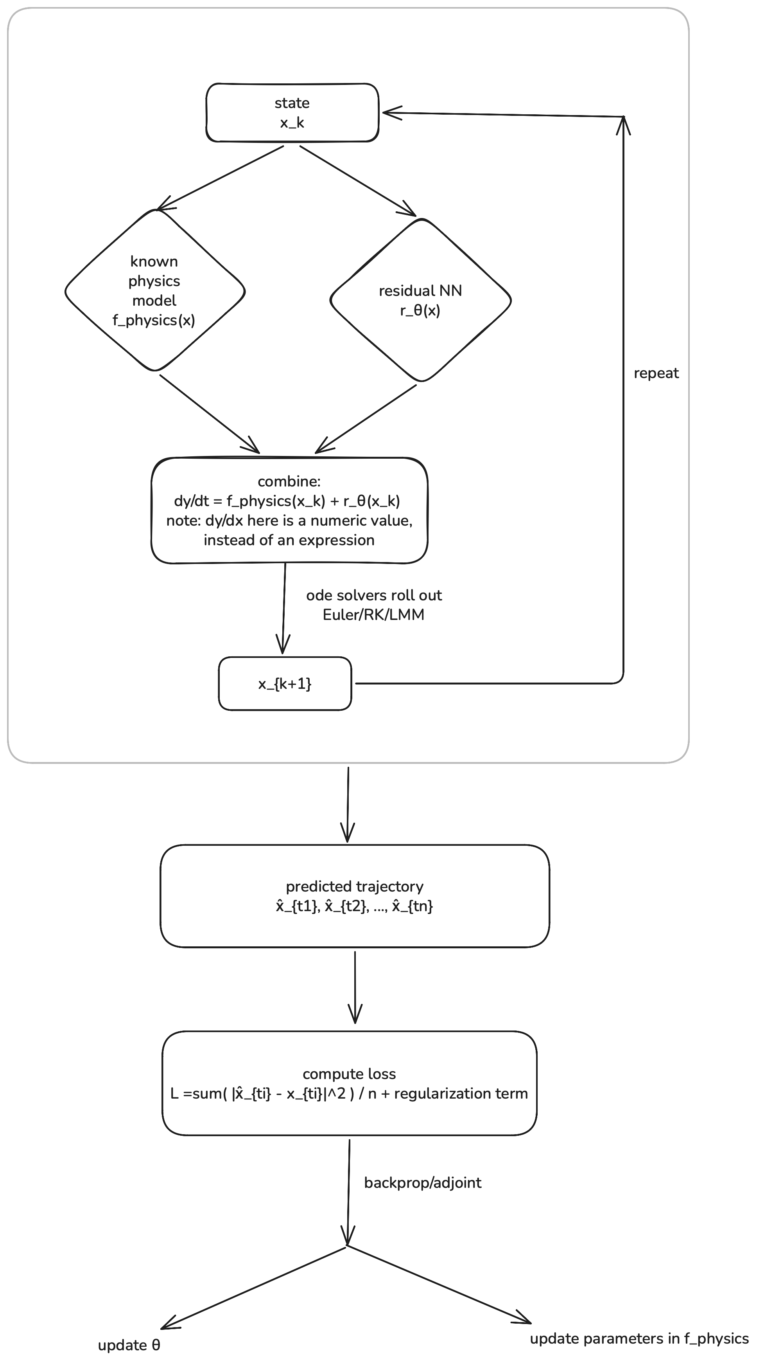
Computational graph

Slide 3
Some thought of JAX
JAX is more like a differentiable programming system more then a dl frame work
To what extend should we learn JAX?

Slide 4
Do we need the encoder for the NN?
Autonomous System or not?

Slide 5
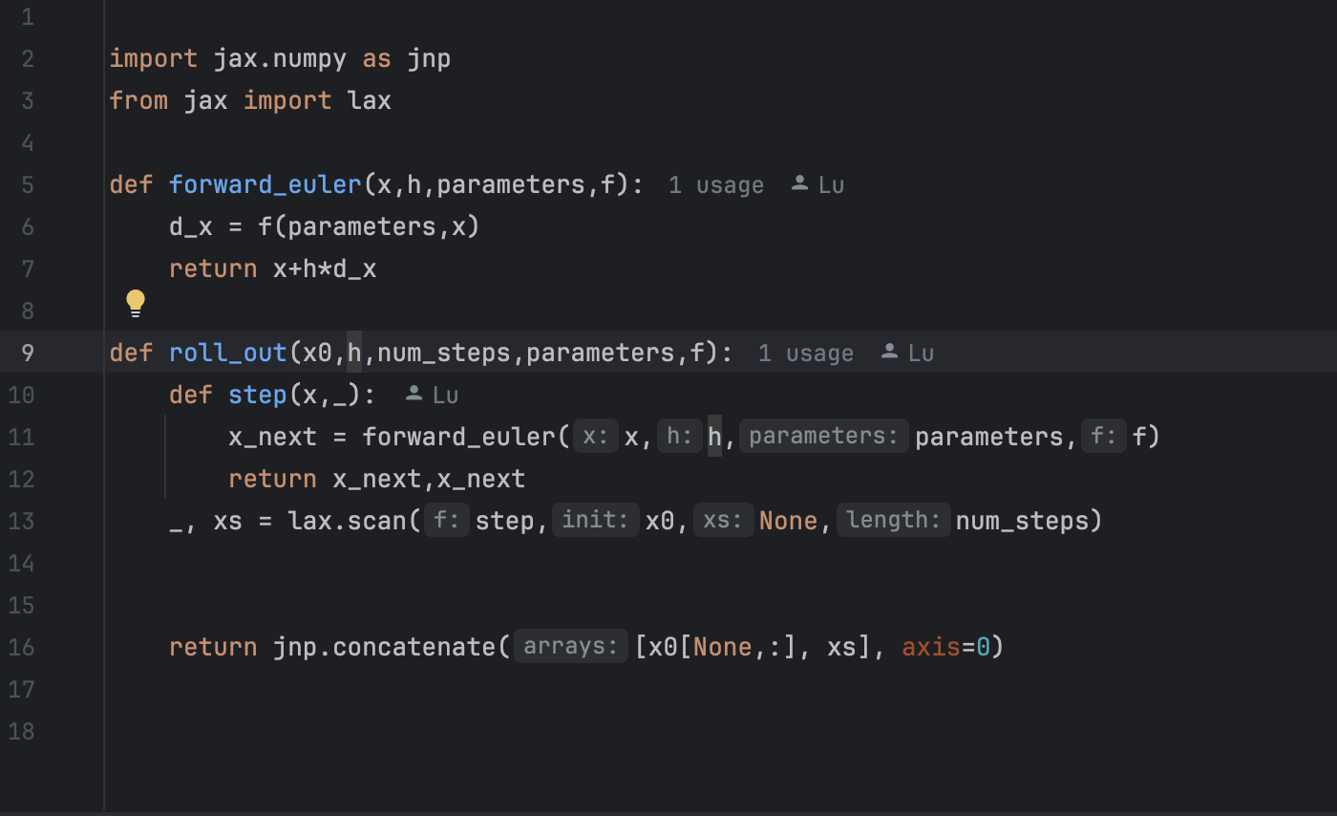
Code Walk Through

Slide 6
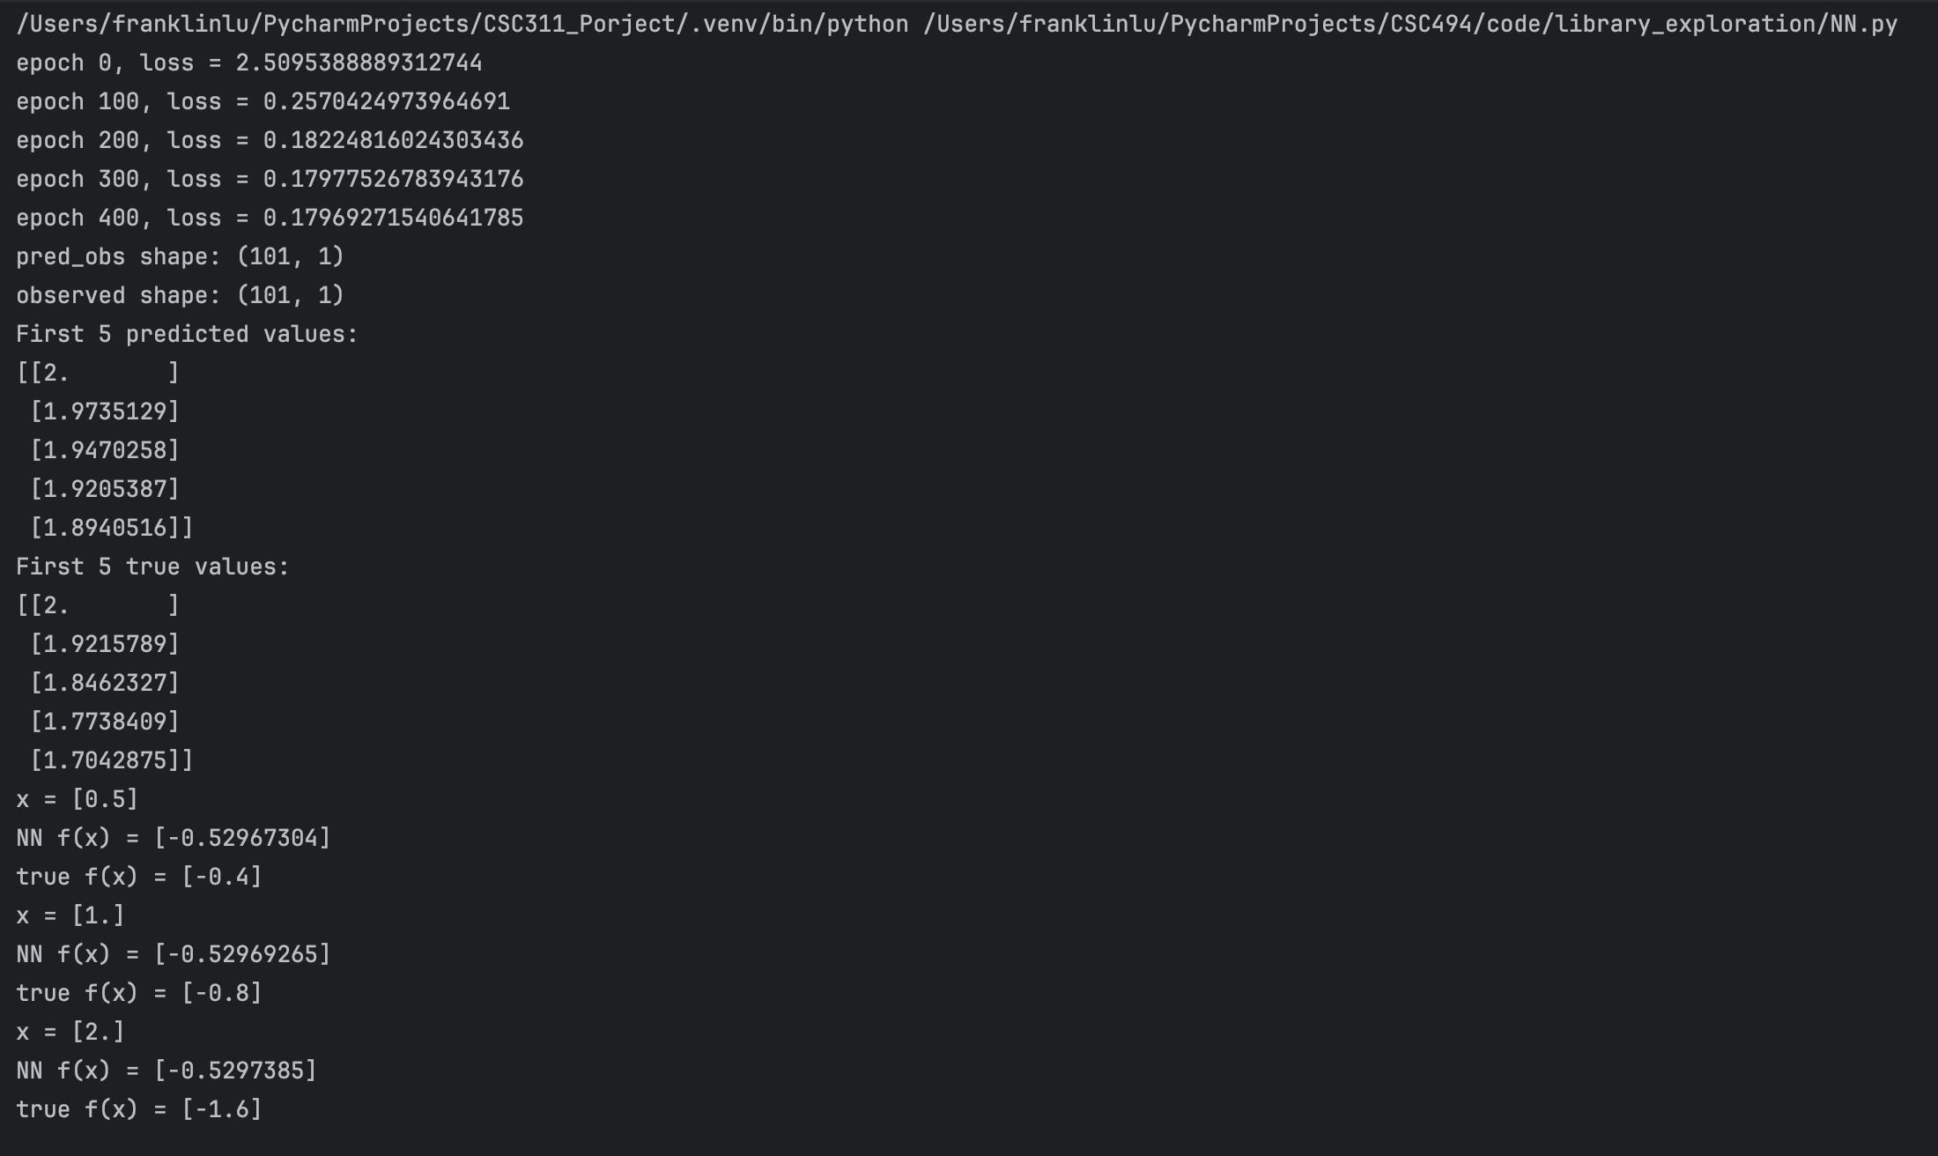
Code Walk through

